Slide 1
INTEGRATED TEMPERATURE, SPO2
AND HEART BEAT MONITOR
SENSORS AND MEASUREMENTS (AM5050)
DINESH KUMAR M (AM23M022)
KAVIYARASAN PR (AM23M025)

Slide 2
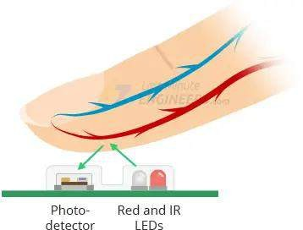
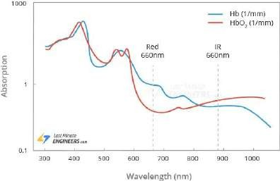
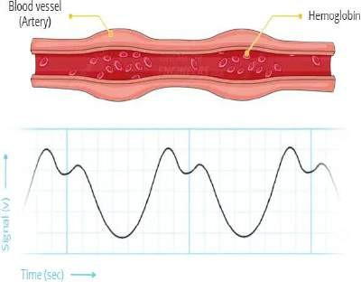
PULSE OXIMETER SENSORS
The MAX30100 sensor consists of two LEDs (Red and IR) and a photodiode.
These two LEDs emit lights at different wavelengths, ~640nm for the red led and ~940nm for the IR LED. At these particular wavelengths, the oxygenated and deoxygenated hemoglobin have vastly different absorption properties.
The oxygenated hemoglobin (HbO2) in the arterial blood has the
characteristic of absorbing IR light.
As the blood is pumped through the finger with each heartbeat, the amount of reflected light changes, creating a changing waveform at the output of the photodetector (when the heart pumps the blood, the oxygenated blood is increased in the body and when the heart relaxes the volume of oxygenated blood is decreased in the body. As a result the changes in the volume of the oxygenated blood, the pulse rate is calculated.)
Absorption-spectrum

Slide 3
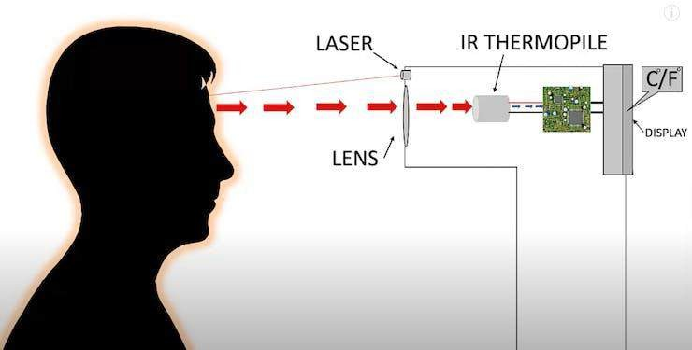
IR BASED TEMPERATURE SENSORS
Infrared thermometers employ a lens to focus the infrared light emitting from the object onto a detector known as a thermopile.
The thermopile is nothing but thermocouples connected in series or parallel.
When the infrared radiation falls on the thermopile surface, it gets absorbed and converts into heat.
Voltage output is produced in proportion to the incident infrared energy. The detector uses this output to determine the temperature, which gets displayed on the screen.

Slide 4
COMPONENTS REQUIRED
MLX90614 - IR Temperature sensor
ESP8266- NODE MCU
SSD1306 OLED DISPLAY
MLX30100 – PULSE OXIMETER SENSOR
Wires and soldering equipments

Slide 5
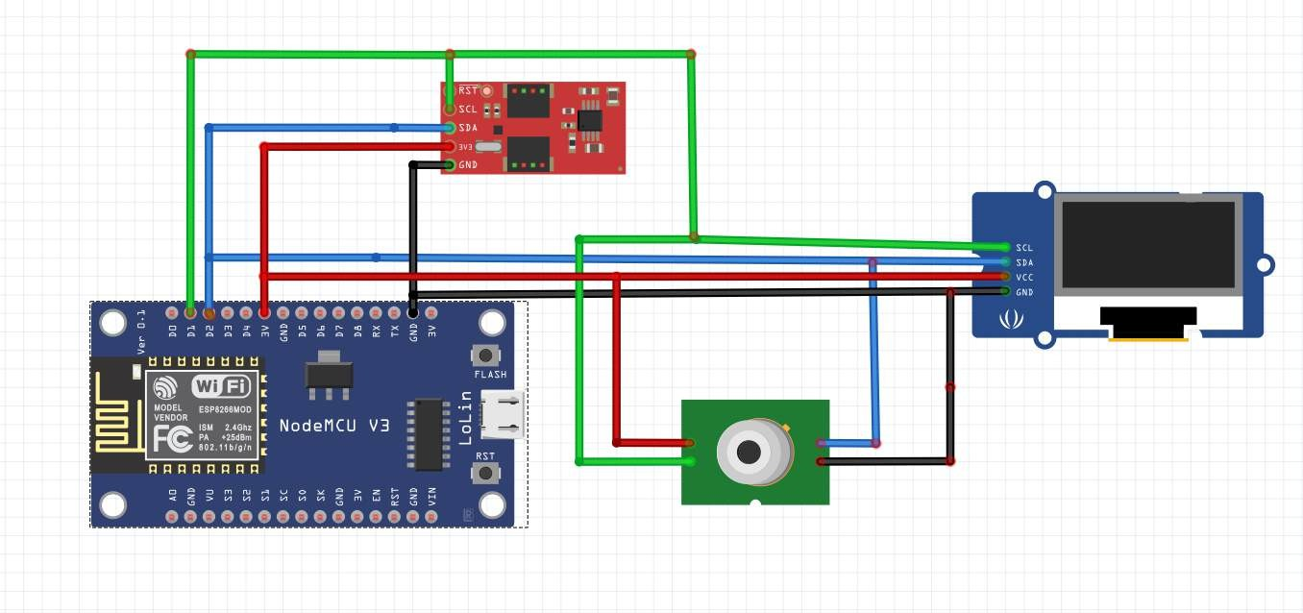
CIRCUIT DIAGRAM

Slide 6
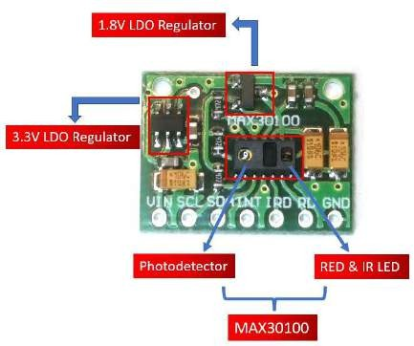
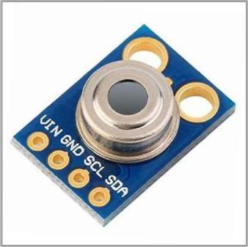
SENSOR CHARACTERISTICS
MLX90614
MLX30100
Operating Voltage | 3.6V to 5V
Input Current | 1.5 mA
Temperature Range | -70˚C to +85˚C
Temperature Accuracy | 0.02˚C
Advantages | Small size , low cost
Factory calibrated in a wide temperature range: | -70 ˚C to 380 ˚C
Operating Voltage | 1.8V to 3.3V
Input Current | 20mA
Temperature Range | -40˚C to +85˚C
Temperature Accuracy | ±1˚C
ADC Resolution | 14 bits
IR LED peak wavelength | 870-900nm
Red LED peak wavelength | 650-670nm

Slide 7

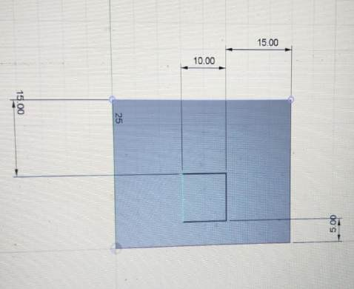
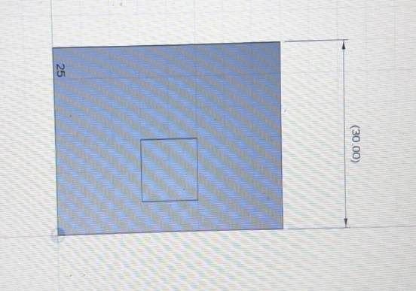
DESIGN
DESIGN CREDITS : ERNEST PONTIFEX J (AM23S020)

Slide 8
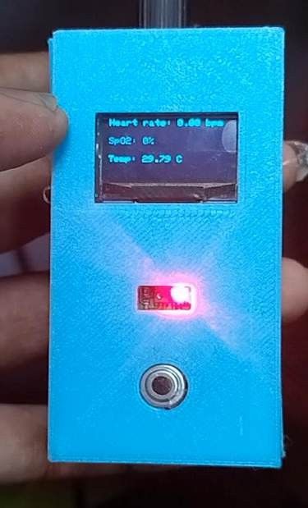
OUTPUT

Slide 9
REFERENCES
https://www.analog.com/media/en/technical-documentation/data- sheets/max30100.pdf
https://www.instructables.com/Infrared-Sensor-With-ESP8266/
https://lastminuteengineers.com/max30100-pulse-oximeter-heart-rate- sensor-arduino-tutorial/
https://www.hackster.io/LithiumION/non-contact-infrared- temperature-sensor-using-arduino-303ca4F

